Slide 1


Go365 by Humana®
2024 well-being
and rewards
For agent use only. Not intended for the general public. Confidential and proprietary information.
GHHKE65EN_rev 0523

Slide 2

What is Go365?
Go365 by Humana® is a wellness program that rewards members for completing eligible activities that help them take control of their whole-person health.
It’s easy. Members can activate their account through MyHumana and start participating in eligible activities.
It’s personal. Go365 lets members decide what matters most to them on their path to well-being and delivers an experience to match.
It’s rewarding. Members earn rewards they can redeem for gift cards in the Go365 Mall.
For agent use only. Not intended for the general public. Confidential and proprietary information.

Slide 3

Agent testimonial video

Slide 4
Why Go365 should matter to you
of members said Go365 was one of the reasons they decided to renew with Humana¹
48%
54%
higher application rate for agents* that engage in Go365 content, compared to agents that do not engage²
*Application rate of partner field agents
¹2020 Medicare member quantitative survey
²2023 Marketbridge Go365 agent engagement analysis

Slide 5



How does it work?
1
2
3
Complete eligible healthy activities
Earn rewards
Redeem for gift cards in the Go365 Mall
For agent use only. Not intended for the general public. Confidential and proprietary information.

Slide 6
Medicare
2023 – 2024 MA comparison
2023 program
Activity | Reward value
Maintain your health: Preventive screenings
Annual Wellness Visit | $25
Mammogram | $30
Colorectal screening (test kit $20 or full exam $50) | $20-$50
Bone density screening | $20
Diabetic eye exam | $25
Hemoglobin A1c (HbA1c) test | $10
Get involved: Social and health education example activities
Attend a Humana Neighborhood Center class | $40 total $5 once per month, 8 times per year
Athletic event (e.g., 5k walk/run, cycling)
Volunteering
Fitness or lifestyle class (e.g., yoga, dancing, painting)
Get active: Exercise and Fitness
12 workouts per month—Tracked via SilverSneakers®, fitness device, online or paper-based tracker (minimum of 5000 steps/day) | $60 total $5 once per month, 12 times per year
2024 program
Activity | Reward value
Maintain your health: Preventive screenings
Annual Wellness Visit | $25
Mammogram OR Colorectal screening | $50
Diabetic bundle (complete all 4 screenings for $40 reward) | $40
Diabetic kidney function urine test
Diabetic kidney function blood test
Hemoglobin A1c (HbA1c) test
Diabetic eye exam
Get involved: Connect and learn
Attend a health education or art class, participate in an athletic event, social club, or religious gathering or event. | $5 total
Complete enroll and onboard online through Humana.com (new members only) | $5
Get active: Exercise and Fitness
Complete a minimum of 12 workouts per month, tracked via SilverSneakers®, fitness device, online or paper-based tracker (minimum of 5000 steps/day). Other physical activities may include golfing, swimming, Zumba, yoga, strength training, etc. | $20 total $5 once per month, 4 times per year
Notes:
What’s different?
Preventive screenings
-Removed reward for bone density screening
-Diabetic screening bundling – members need to compete all 4 diabetic screenings to earn the $50 reward
Social and health education changing to Digital and health education
-Added reward for members to update or add their email, as well as sign up for email or text communications
-Total reward earning opportunity from this category capped at $20 vs $40 last year
Exercise and fitness category – remaining the same
-Reminder that there was an increase in 2023 in amount of steps/day needed to earn reward >> from 500 to 5,000/day

Slide 7
Medicare
2023 – 2024 DSNP comparison
2023 program
Activity | Reward value
Maintain your health: Preventive screenings
Annual Wellness Visit | $25
Mammogram | $30
Colorectal screening (test kit $20 or full exam $50) | $20-$50
Bone density screening | $20
Diabetic eye exam | $25
Hemoglobin A1c (HbA1c) test | $10
Get involved: Social and health education example activities
Attend a Humana Neighborhood Center class | $40 total $5 once per month, 8 times per year
Athletic event (e.g., 5k walk/run, cycling)
Volunteering
Fitness or lifestyle class (e.g., yoga, dancing, painting)
Get active: Exercise and Fitness
12 workouts per month—Tracked via SilverSneakers®, fitness device, online or paper-based tracker (minimum of 5000 steps/day) | $60 total $5 once per month, 12 times per year
2024 program
Activity | Reward value
Maintain your health: Preventive screenings
Annual Wellness Visit | $25
Mammogram | $30
Colorectal screening | $50
Diabetic bundle (complete all 4 screenings for $40 reward) | $40
Diabetic kidney function urine test
Diabetic kidney function blood test
Hemoglobin A1c (HbA1c) test
Diabetic eye exam
Get involved: Connect and learn
Attend a health education or art class, participate in an athletic event, social club, or religious gathering or event once per month. | $20 total $5 once per month, 4 times per year
Complete enroll and onboard online through Humana.com (new members only)
Get active: Exercise and Fitness
Complete a minimum of 12 workouts per month, tracked via SilverSneakers®, fitness device, online or paper-based tracker (minimum of 5000 steps/day). Other physical activities may include golfing, swimming, Zumba, yoga, strength training, etc. | $60 total $5 once per month, 12 times per year
Notes:
What’s different?
Preventive screenings
-Removed reward for bone density screening
-Diabetic screening bundling – members need to compete all 4 diabetic screenings to earn the $50 reward
Social and health education changing to Digital and health education
-Added reward for members to update or add their email, as well as sign up for email or text communications
-Total reward earning opportunity from this category capped at $20 vs $40 last year
Exercise and fitness category – remaining the same
-Reminder that there was an increase in 2023 in amount of steps/day needed to earn reward >> from 500 to 5,000/day

Slide 8
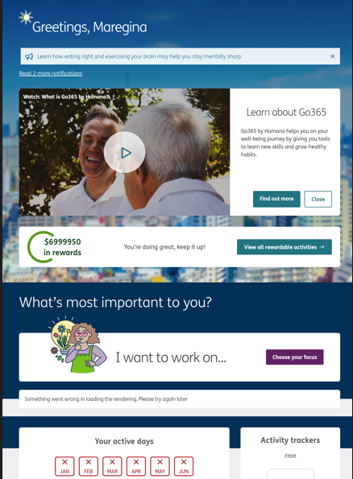
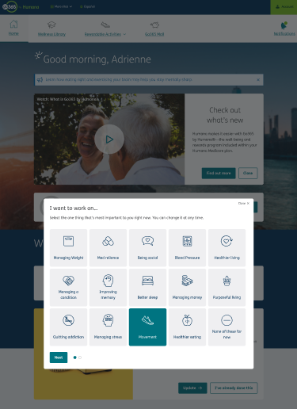
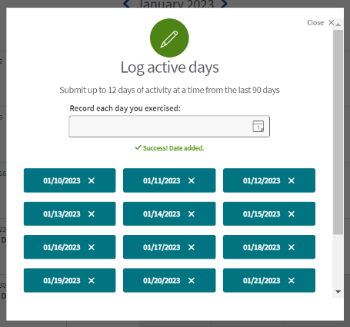
2023 mid-year program enhancements
1
Ability for members to personalize their Go365.com experience. They select areas of health they want to focus on and find relevant articles, videos and podcasts to support their journey.*
2
Expanded library of wellness courses on topics including Diabetes Essentials, Functional Movement, Addiction & Sobriety,
Self-compassion and Eldercare
3
Simpler way for members to log active days on Go365.com
Notes:
Let’s start by taking a look at the changes we’ve to our member experience on Go365.com. These include ….
A more personalized experience where members can select an area of their health to focus on.
Expansion of our library of popular, expert-led wellness courses
Easier way for our members to log both their active days and social & health education activities

Slide 9
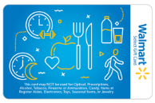





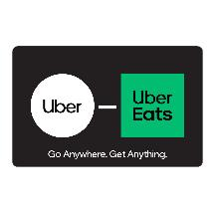

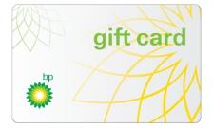



















Go365 by Humana: 2024 rewards
Redeem rewards for gift cards:
Online: Sign in at go365.com/shop OR
Phone: Call 866-677-0999
We remain committed to providing rewards to assist our members facing barriers to health in their daily lives, including food insecurity, housing and transportation.
Rewards have no cash value and can only be redeemed in the Go365 Mall. Rewards must be earned and redeemed within the same program year. Rewards not redeemed by Dec. 31 will be forfeited. Only the member can redeem rewards and order gift cards. Some items in this catalog may have been discontinued, and new items may be available for redemption. For the most current list, visit Go365.com or call 1-866-677-0999. These gift cards cannot be used to purchase prescription drugs or medical services that are covered by Medicare, Medicaid or other federal healthcare programs, alcohol, tobacco, e-cigarettes, or firearms. These cards must not be converted to cash.
For agent use only. Not intended for the general public. Confidential and proprietary information.
Notes:
Here are the various gift cards that members on eligible Humana Medicare Advantage plans that include Go365 can redeem in the Go365 Mall.

Slide 10




Getting members started
For members who have Go365 as part of their plan, the quickest way to get started is to:
Sign in at MyHumana.com
If your members have a MyHumana username and password, they can use that to get access to Go365. If not, have them activate their online profile on MyHumana.com today.
Members also can request paper materials by calling the number on the back of their member ID card.
For agent use only. Not intended for the general public. Confidential and proprietary information.

Slide 11
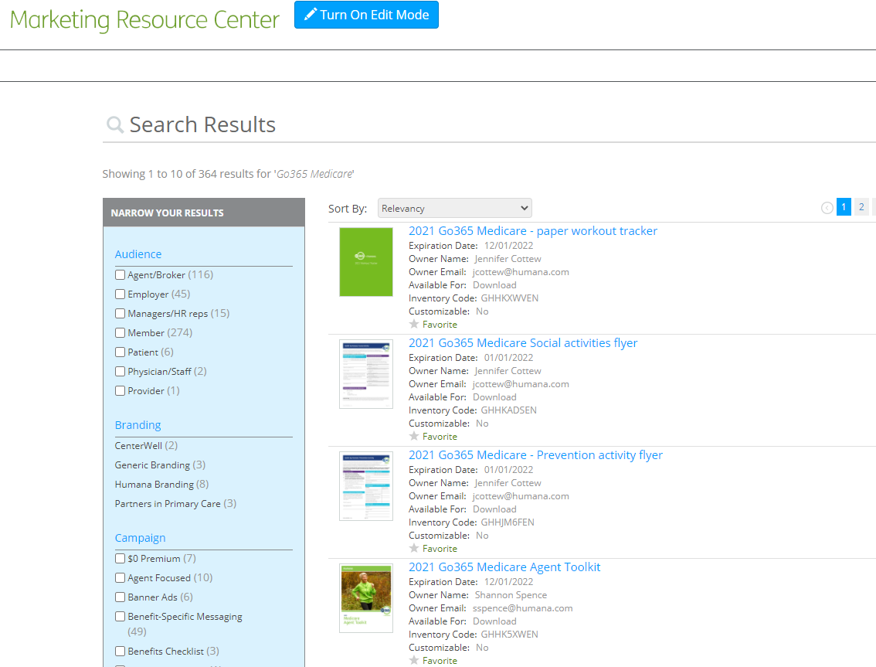
Tips for finding resources on the MRC
Enter “Go365” in the search bar
Look for items with “Go365 Medicare” in the title
Most items available in Spanish
Most useful documents:
  Customizable “getting started” postcard
  Agent toolkit (includes links to all marketing materials)
For agent use only. Not intended for the general public. Confidential and proprietary information.

Slide 12
Maximize Go365 with your members
Show members how to activate their Go365 account online
Learn more about them and recommend fitness or social activities based on their interests
Share the “Get started” flyer at in-person and virtual events (print a stack out and keep in your car just in case!)
Educate members on the 90-day reward redemption window
Encourage members to redeem their rewards digitally to help them access their gift cards sooner rather than later.
Share the Go365 Mall automated phone number (1-866-677-0999)
Go365 information should only be shared with members that have Go365 available on their plan.

Slide 14
Rewards have no cash value and must be earned and redeemed within the same plan year. Rewards not redeemed before December 31st will be forfeited.
In accordance with the federal requirements of the Centers for Medicare and Medicaid Services, no amounts on the gift cards shall be used to purchase covered medical supplies or prescription drugs nor are they redeemable for cash.
The merchants represented are not sponsors of Go365 or otherwise affiliated with Go365. The logos and other identifying marks attached are trademarks of and owned by each represented company and/or its affiliates. Please visit each company's website for additional terms and conditions.
For agent use only. Not intended for the general public. Confidential and proprietary information

Slide 15
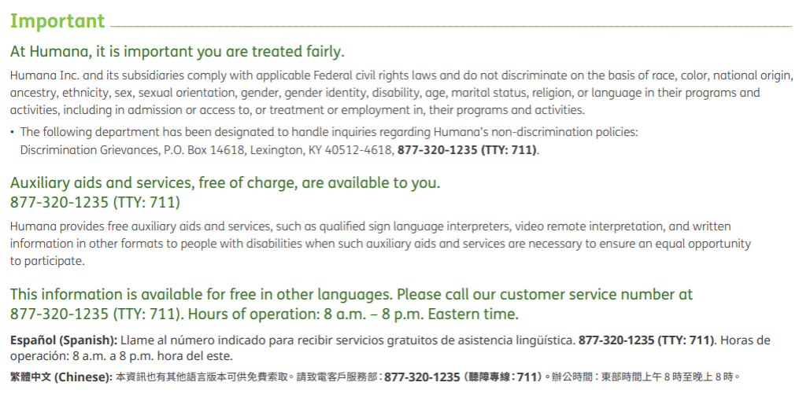
For agent use only. Not intended for the general public. Confidential and proprietary information

